Slide 1
LoadRunner &
Performance Center
Overview

Slide 2

Agenda
LoadRunner
Overview
Components & Architecture
Virtual User Generator – Basic Features
Controller & Analysis – Basic Features
Integration & Other Facilities

Slide 3
LoadRunner - Overview

Slide 4
LoadRunner Overview
What is LoadRunner?
LoadRunner is a performance testing tool used to measure system behavior and performance under load.
How does it work?
It simulates the real-world user’s actions and helps to identify the performance of the software application or system by generating virtual load.
Brief History:
1999 – Pioneered by Mercury Interactive Corporation
2006 - Hewlett Packard Enterprise acquired LoadRunner, renamed HPE LoadRunner
2015 – Notable enhancements including Chrome TruClient support added, JavaScript as scripting language, generating script from HAR files etc.
2016 – Micro Focus acquired HPE LoadRunner

Slide 5
LoadRunner Overview
Why LoadRunner:
LoadRunner has a simple and interactive user interface
LoadRunner reduces the requirement of physical testers by replacing real (physical) users with virtual users (Vusers)
Wide variety of protocols available to simulate real world scenarios (Web http/html, Citrix, RTE, RDP, SAP GUI, Ajax TruClient etc.)
Ease of integration with APM tools
On-premise and cloud options are available
Easy correlation method (to handle the dynamic values coming from the server). Also, intelligent auto-correlation feature

Slide 6
LoadRunner Overview
Widely used performance testing solution
Simulate thousands of users concurrently
Used to test applications
Measure system behavior and performance
Identify performance issue
Cost is based upon number of Vuser License
Supports wide range of protocols (e.g. Web (http/html), Citrix, RTE, RDP, SAP GUI, Ajax TruClient etc)

Slide 7
LoadRunner – Components & Architecture

Slide 8
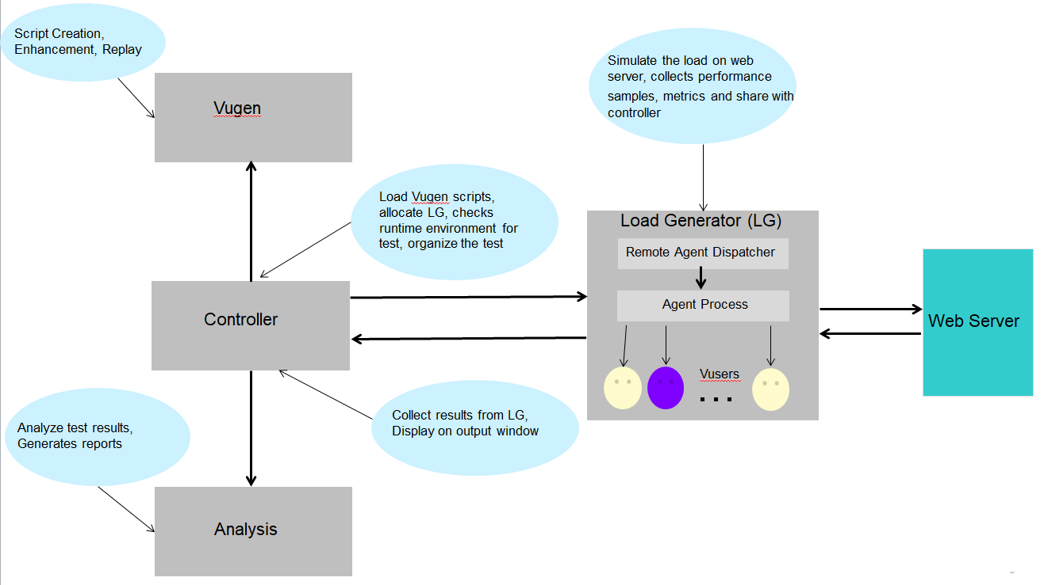
LoadRunner Components & Architecture
Virtual User Generator (aka Vugen):
Script creation & enhancement
Error handling & compilation
Debugging & Script execution
Validation & Verification
Controller:
Scenario design
Performance test execution
Performance metrics Collection
Live monitoring of the test
Load Generator:
A machine upon which the Remote Agent Dispatcher (Process) and a LoadRunner agent process are installed.
Remote Agent Dispatcher : Enables Controller to start LoadRunner Agent on the load generator machine.
Agent Process: Receives instructions from Controller to initialize, run, pause, and stop Vusers. Also sends Vusers status back to Controller.
Analysis:
Result Analysis
Report Generation
Graphical representation of performance metrics

Slide 9
Q&A
Which protocol is used to measure the performance of Thick Client Application?
Web HTTP/HTML
TruClient
RDP
SAP GUI
Which component of LoadRunner shows the response time status during load test?
Vugen
Controller
Load Generator
Analysis

Slide 10
Virtual User Generator

Slide 11
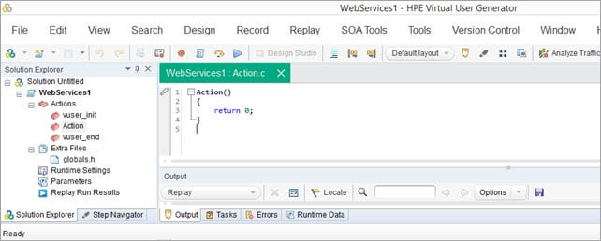
Virtual User Generator
What is Vugen?
VuGen or Virtual User Generator is an IDE (Integrated Development Environment) or a rich coding editor.
It is used to replicate System Under Load (SUL) behavior.
It provides a “recording” feature which records communication to and from client and Server in form of a coded script.

Slide 12
Virtual User Generator
Script development process
Record the Script: The first step of scripting where every user action as part of business flow is recorded into a script
Enhance the Script: Once recording has been verified, enhance script by adding checkpoints, validating data, adding transactions and rendezvous points.
Replay and Verify: As earlier, re-play your script and verify that everything is working as intended.
Configure Runtime Settings: Configure and control pacing duration, think time variation, proxy settings and timeout settings.
Use for Load Scenarios: Formulate load scenarios based on test objectives. Use load distribution and geo-wide agents to make real like scenarios

Slide 13
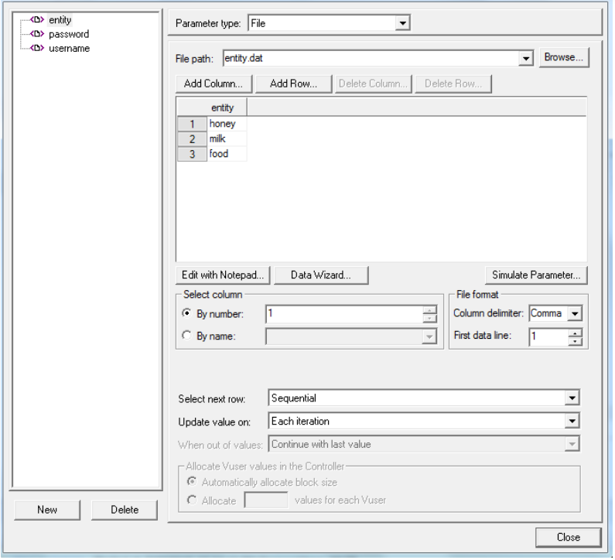
Virtual User Generator
Transaction: User action such as single click on button, click on link.
Iteration: Set of consecutive actions or transactions
Parameterization: Mechanism to pass client side / user data e.g. user id, password, search string etc.
Correlation: Mechanism to handle server side dynamic data e.g. session ID, token ID, order ID etc.
Functions: Vugen provides a great number of functions to be used to enhance the script. Few examples are as below
lr_start_transaction
lr_end_transaction
lr_eval_string
lr_save_string
lr_think_time
web_reg_save_param()
web_reg_find()

Slide 14
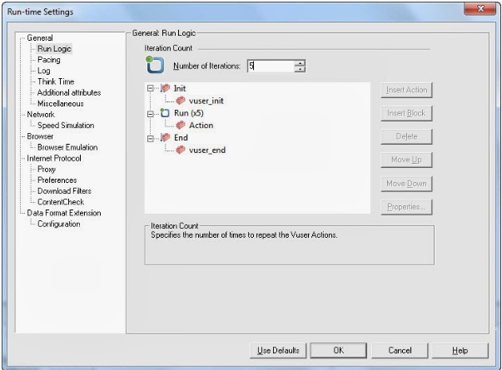
Virtual User Generator
Run-time Settings
Settings of number of iterations, pacing, think time, logs, proxy setting & many more
Run-Logic: Way of executing script
Pacing: Wait time between iteration
Log: Setting Logging levels
Think time: Wait time between transaction
Browser Emulation: Uses browser string to simulate the requests
Proxy: Used for running script via a proxy address

Slide 15
Q&A
Which function is used to identify a text on response in vugen?
web_reg_save_param()
web_reg_find()
web_set_user()
web_set_max_html_param_len()
Where can we set value for time between two iterations in vugen?
Action file
Runtime Settings
Parameters
None of the above

Slide 16
LoadRunner Controller

Slide 17
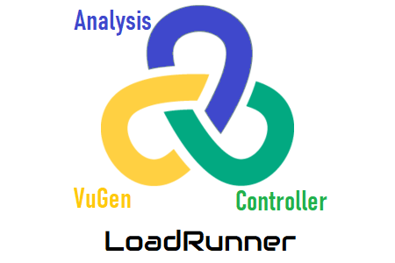
Controller - Basic Features
What is Controller?
The controller is the most crucial component of the architecture as it manages the load simulation.
Some other functions that it performs include:
IP spoofing
Error reporting
Nature of Load scenario
Handling Vusers behavior

Slide 18
Controller - Basic Features
Design Tab:
Scenario scripts: Set of scripts & run time setting for test execution, number of Vusers, Load Generator, Ramp up, Ramp down, Steady state design (Example – 300 Vusers, 10 scripts, 3 hrs steady state, 1 LG, 10 mins for ramp up, 15 mins for ramp down)
Scenario schedule: Allows to set up run mode and schedule details for your test
Run Mode: Real-world Schedule, Basic Schedule
Global schedule: Allows you to set up vuser ramp up, steady state and ramp down pattern for your test
Steady Sate : Stable state of Vusers accessing application concurrently.
Run Tab:
Scenario groups: Shows vuser status for each script group
Scenario Status: Shows number of running vuser, elapsed time, pass/fail transactions, errors
Graphs: Shows number of graphs depicting different information in graphical manner
Response time status: Shows the minimum, maximum, average, last response time details

Slide 19
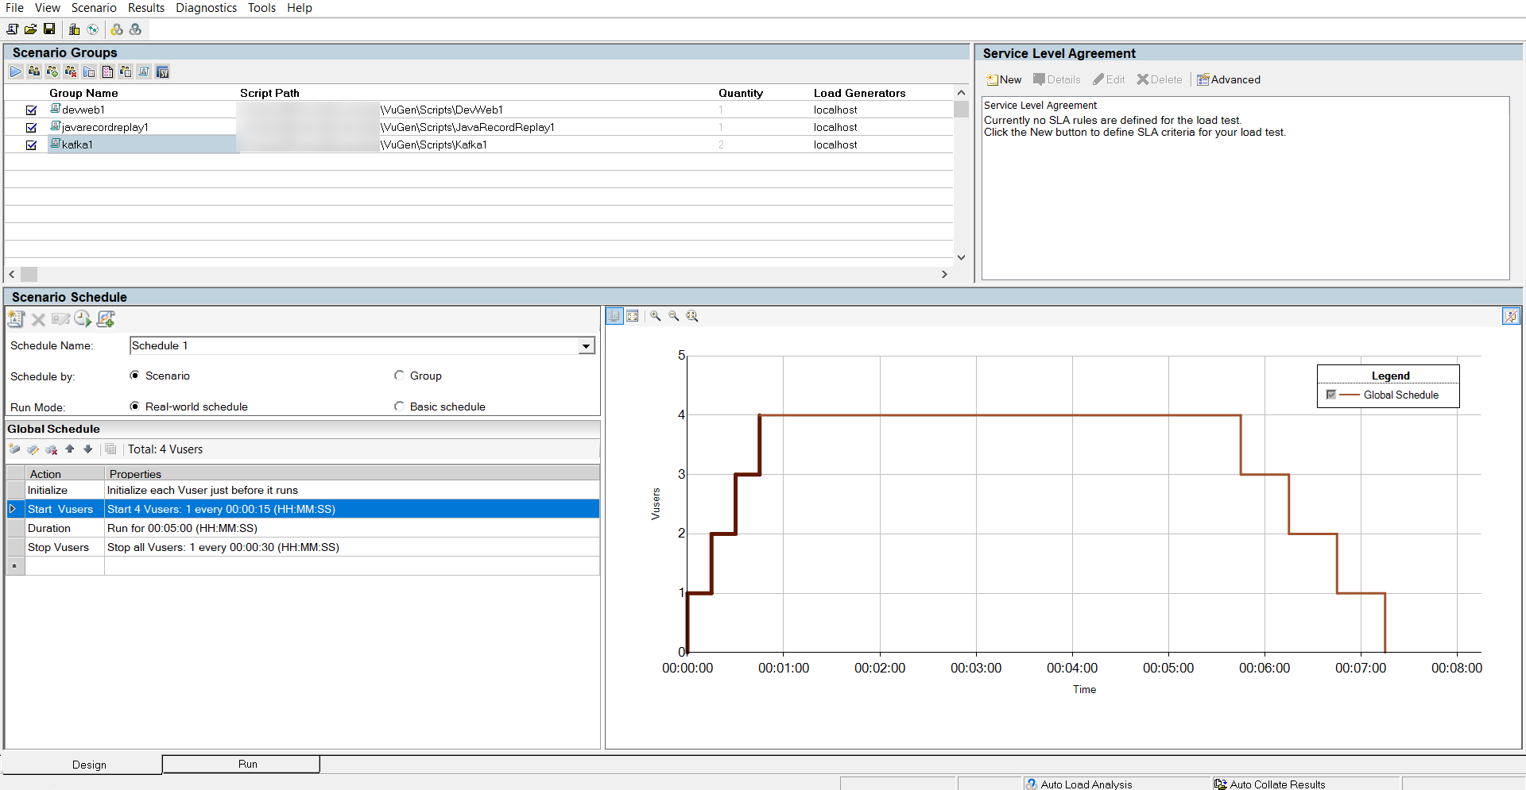
Controller - Basic Features
Design Tab:

Slide 20
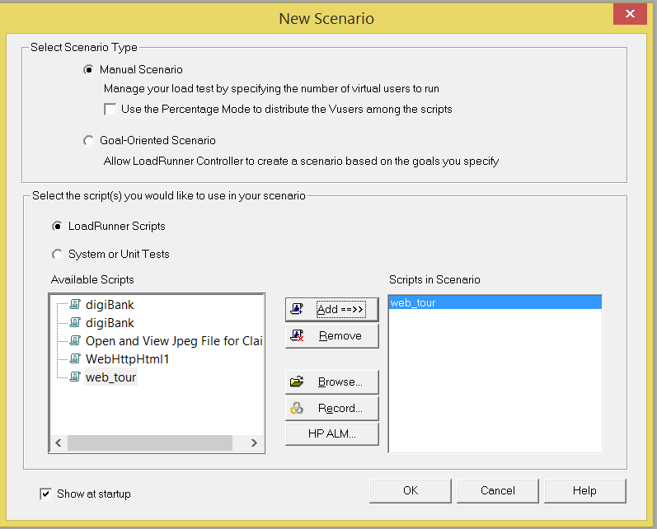
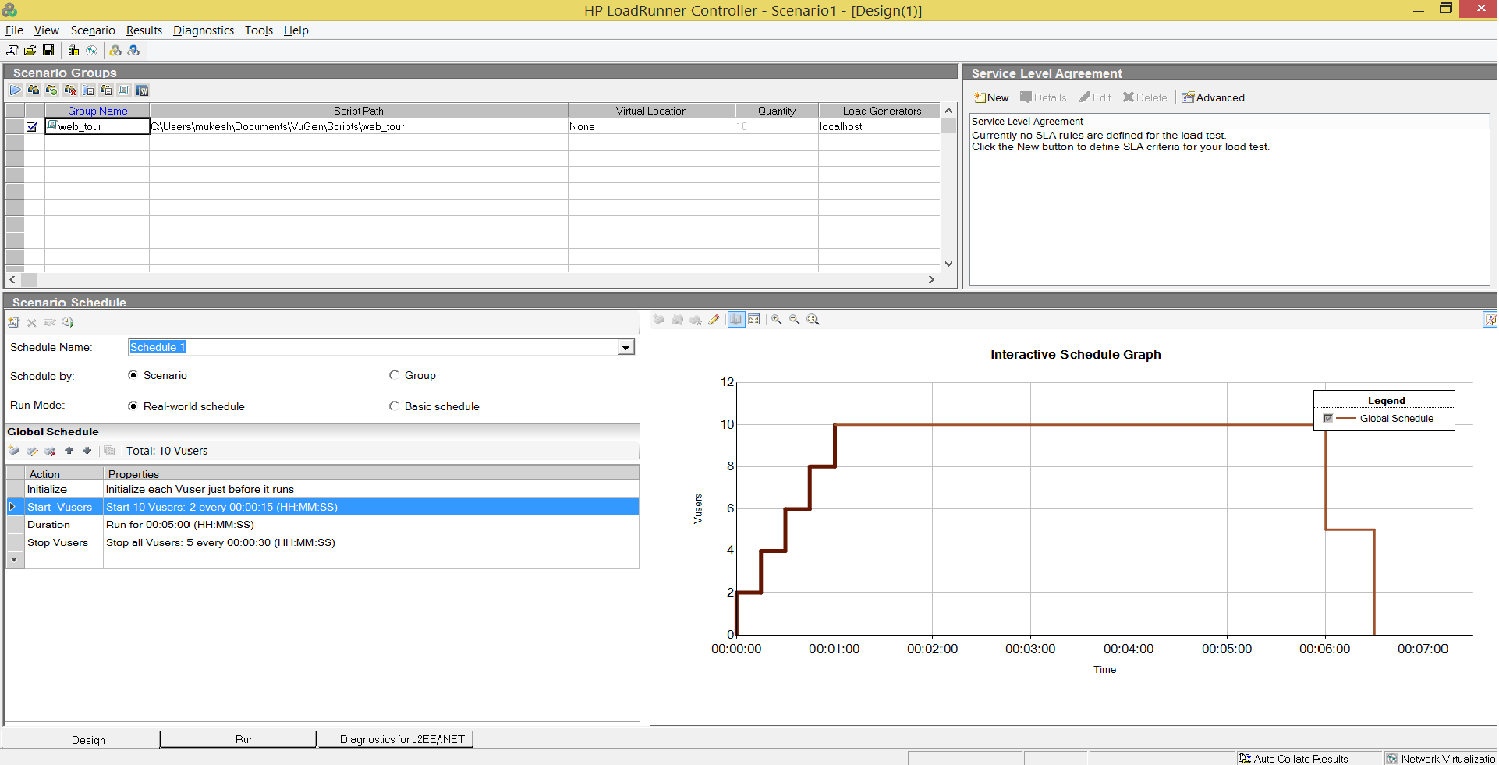
Controller - Basic Features
Select the scripts -> click Add
Test scenario
Click OK

Slide 21
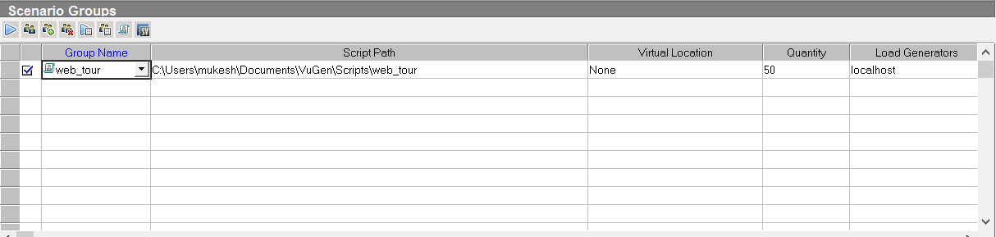
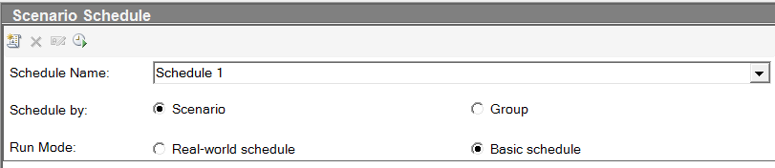
Controller - Basic Features
Scenario Group
Add/remove group
Run time setting
Group Info
View script
Vuser count
Vuser status
Select LG
Run
Scenario Schedule
  Schedule by
    Scenario – same schedule assign to all groups
    Group – schedule assign to each group
  Run Mode
    Real-world schedule - different ramp-up rates and run duration can be applied
    Basic schedule – singe ramp-up and run duration is set for each/all groups

Slide 22
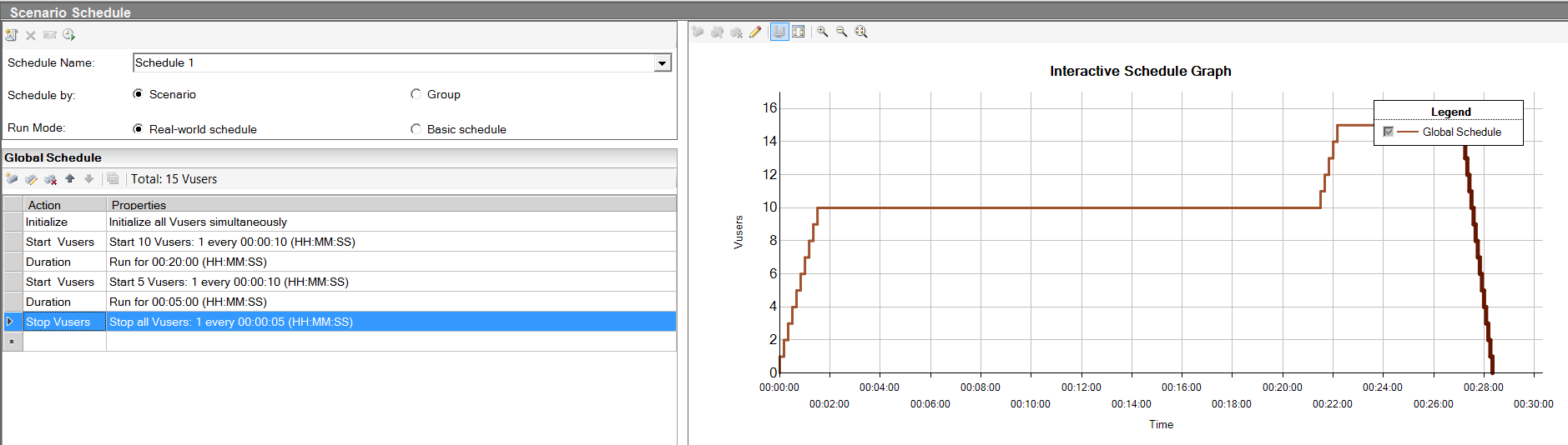
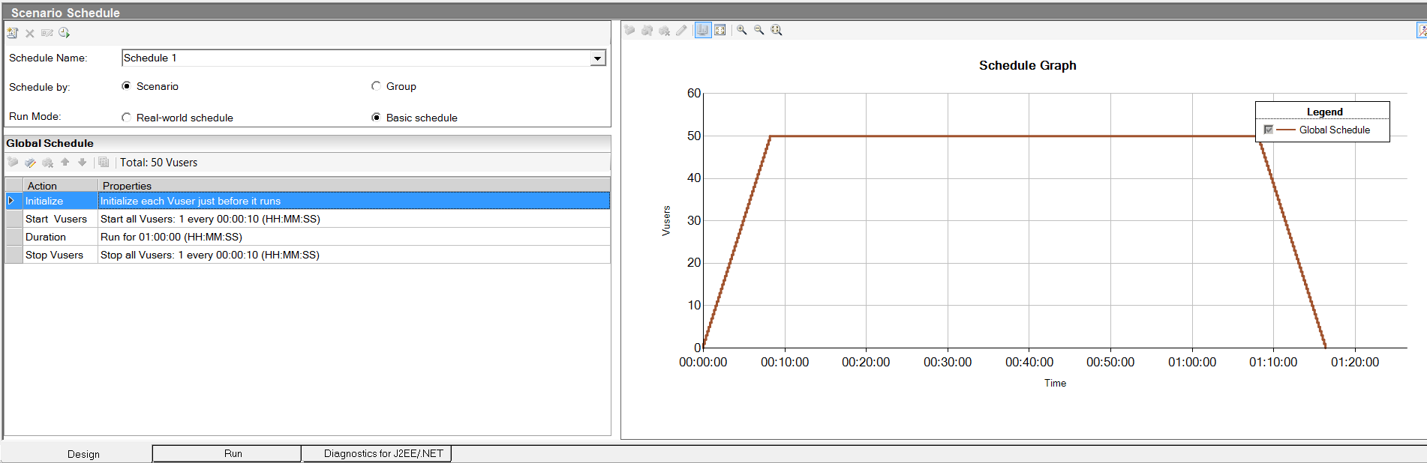
Controller - Basic Features
Real world scenario
Basic schedule scenario

Slide 23
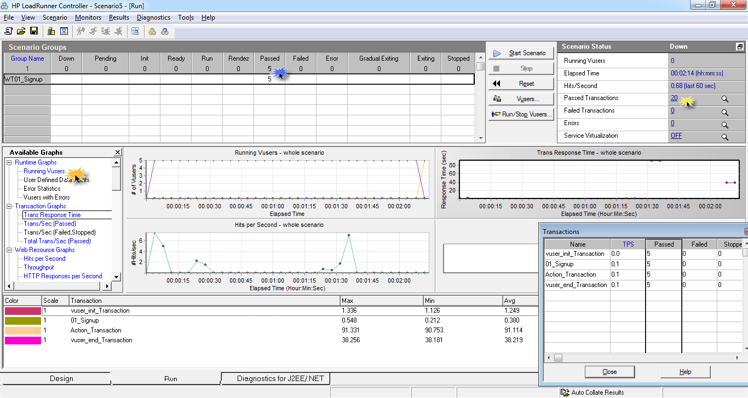
Controller - Basic Features
Run Tab:

Slide 24
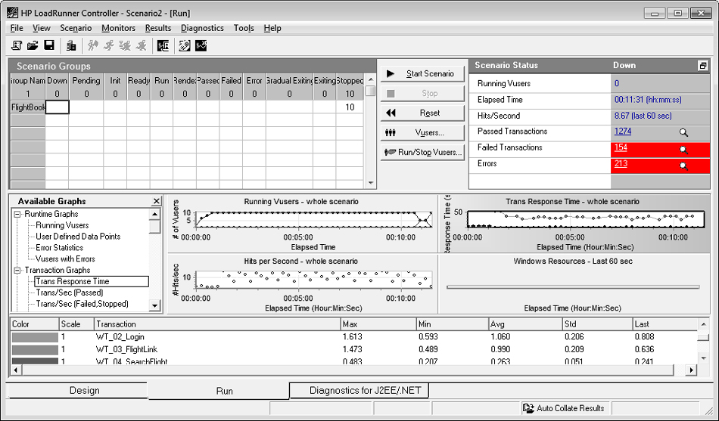
Controller - Basic Features
Execution window
Vusers’ status
Run summary
Available Monitors graphs
Run-time Monitors display window
Response time

Slide 25
LoadRunner Analysis

Slide 26
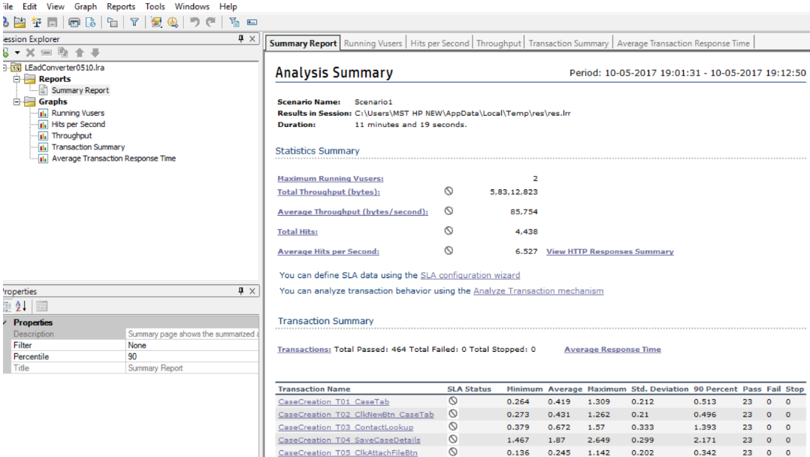
Analysis – Basic Features
As the name suggests, it is a program to perform detailed analysis on the performance test which was executed
Analysis Summary : Processed performance metrics such as transaction response time, pass/fail transactions etc
Graphs: Running Vusers, Avg response time, throughput etc

Slide 27
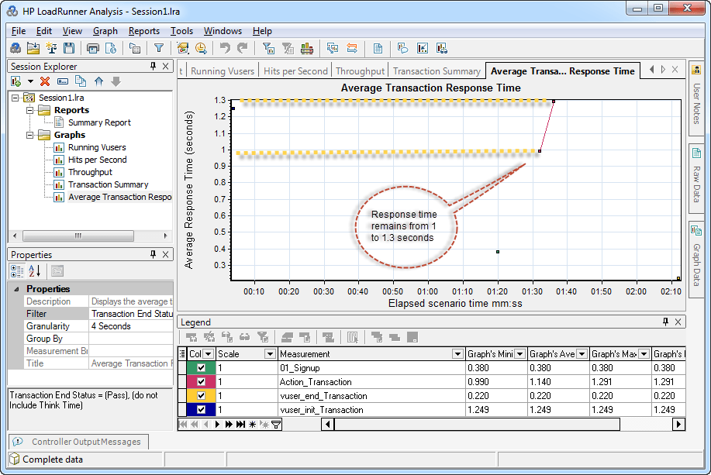
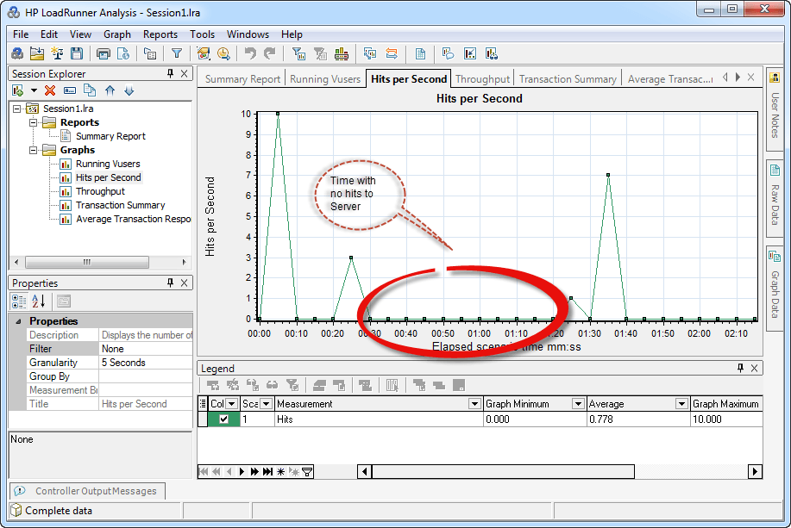
Analysis – Basic Features
Graphs – Avg. Response Time
Graphs – Hits per second

Slide 28
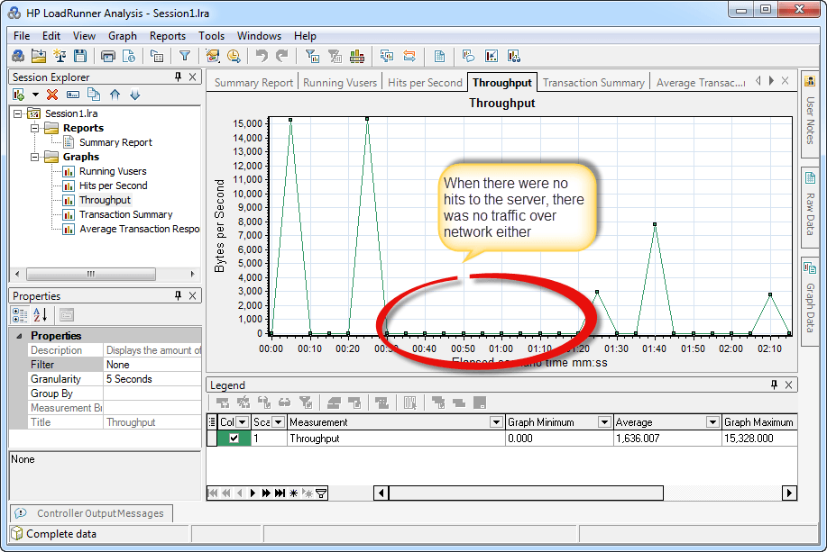
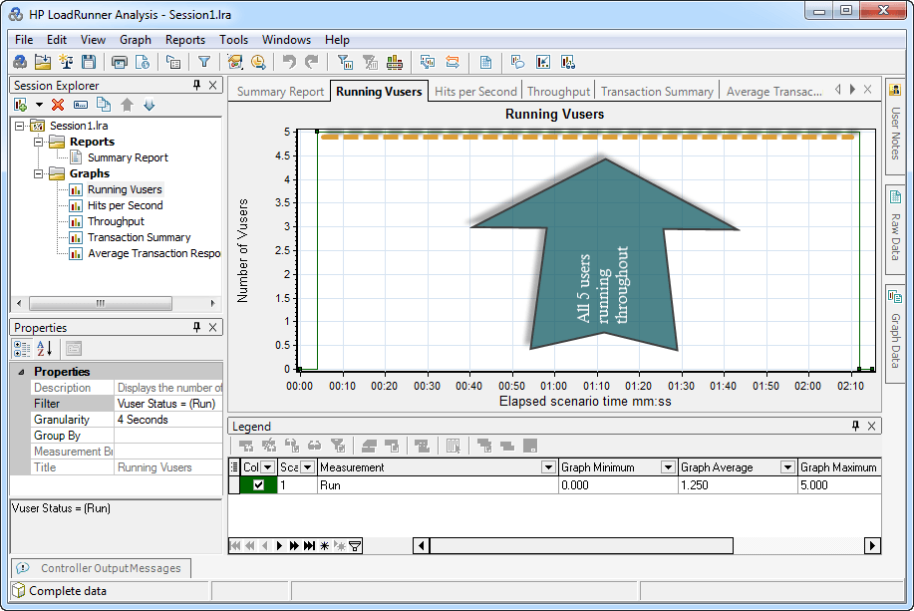
Analysis – Basic Features
Graphs – Throughput
Graphs – Running Vuser

Slide 29
Integration & Other Facilities
Git Integration : In version 12.53, the VuGen integrates with Git, you can store VuGen scripts in a Git or a GitHub repository for collaboration and versioning for agile teams.
Jenkins Integration: Automate the tests using plug-in HP Application Automation Tools.
Stormrunner (LoadRunner as cloud): Supports Vugen scripts, Jmeter & other scripts.
Support for additional Virtual Table Server (VTS) APIs
New cloud provider DigitalOcean that allows you to now provision load generators with Amazon EC2, Microsoft AZURE, Google Compute Engine, and DigitalOcean
More learning & information at:
www.microfocus.com/loadrunner
www.microfocus.com/performancecenter
https://community.microfocus.com/

Slide 30
Q&A
Which scenario schedule is best suited for Step Load Test?
Basic Schedule
Real-world Scenario
Which of the following graphs displays the amount of data that the VUsers received from the server?
Average Response Time graph
Hits Per Second graph
Throughput graph
None of the above

Slide 31
Thank you

